Slide 1
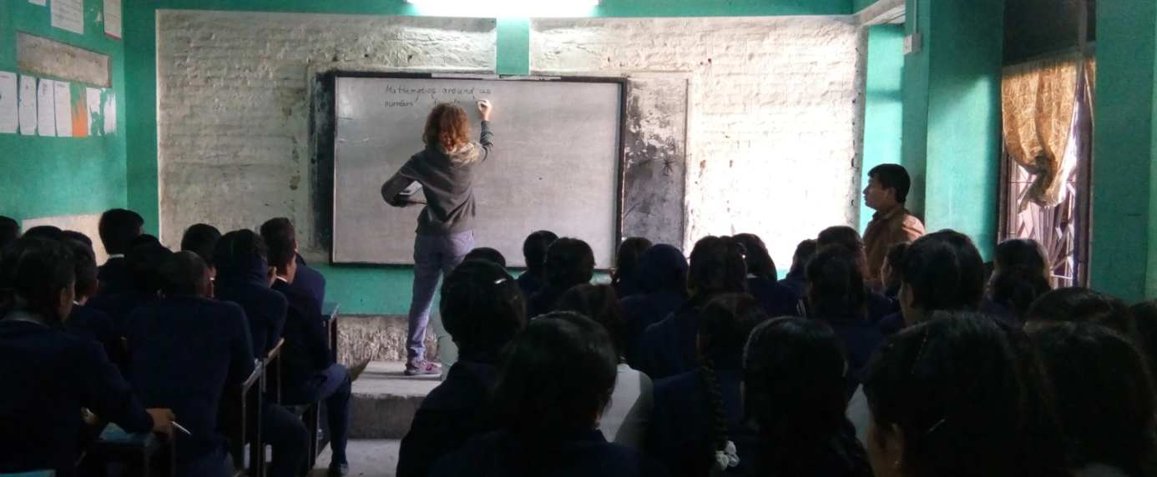
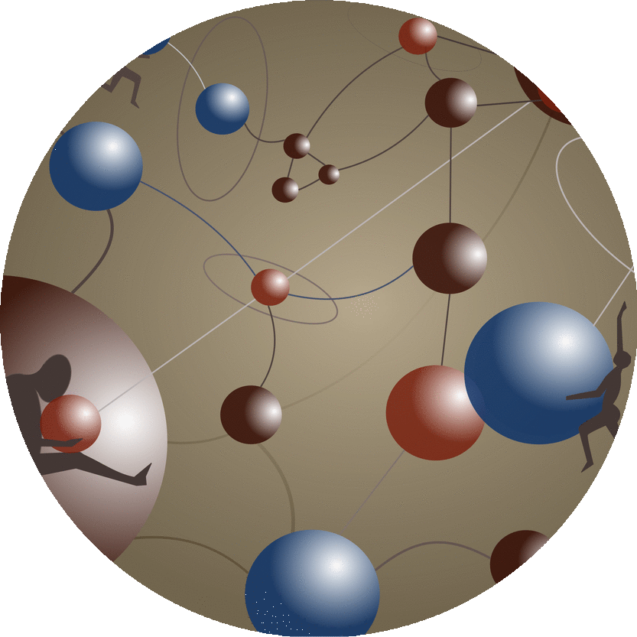








Lecturers without borders
(LeWiBo)
“Meeting Science and Education”
January 2020

Slide 2
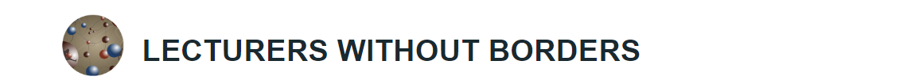
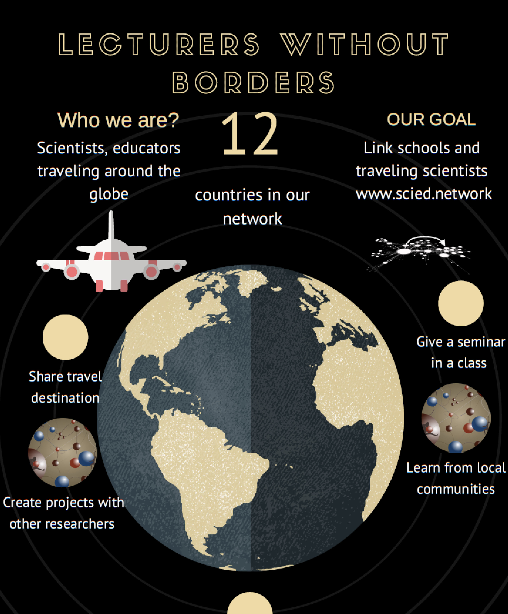

Motivation
Our main target - to inspire the high school students and to raise their motivation in learning science.
Science 31 May 2019: Vol. 364, Issue 6443

Slide 3
Who We Are: Core Team
Board:
Liubov Tupikina
(RU, FR) researcher
Delphine Clara Zemp
(FR, INDONESIA) researcher
Athanasia Nikolaou
(GR, IT) researcher
Mikhael Khotyakov
(RU, DE) teacher/educator
Coordinator
Anastasia Mityagina
(RU, DE) coordination officer

Slide 4
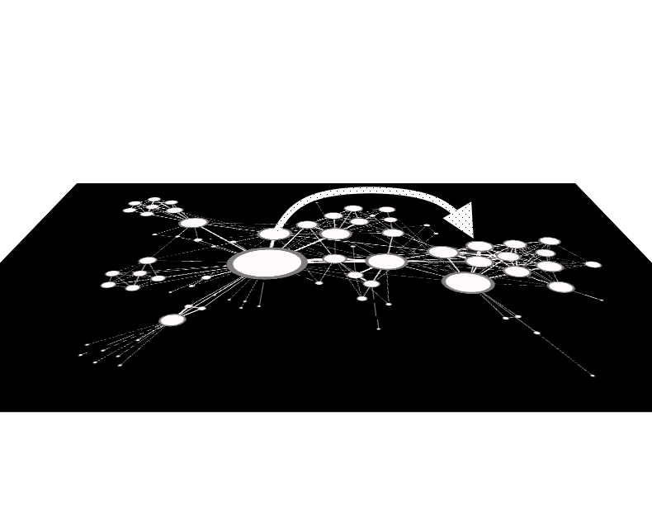
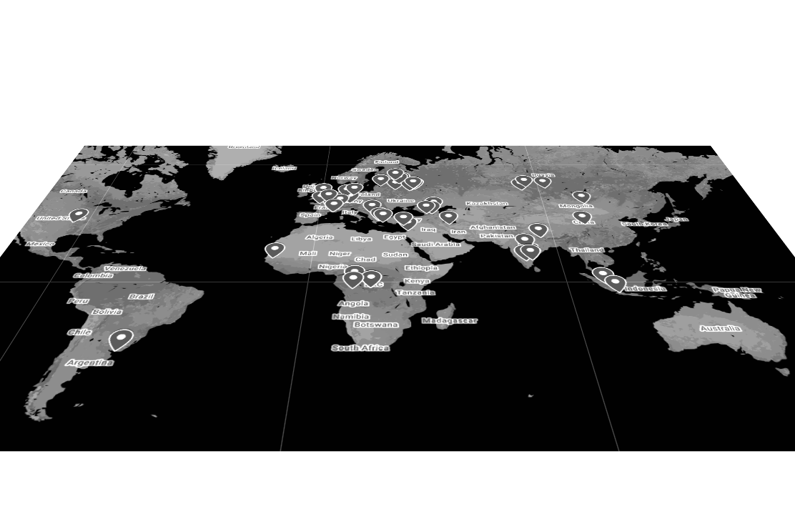
Open network of educators and researchers www.scied.network
System Prototype
How does it work?
Researchers register on the LeWiBo platform via webpage
Before travelling they contact the local coordinator from the country they live/travel to (you will receive the email with the contacts of local coordinators)
Coordinator finds a host from the nodes in the LeWiBo network.
Growing into Digital Platform:
As soon as the network will be expanded the project will launch a digital platform to ensure an authomatic conection between lecturers and schools.

Slide 5
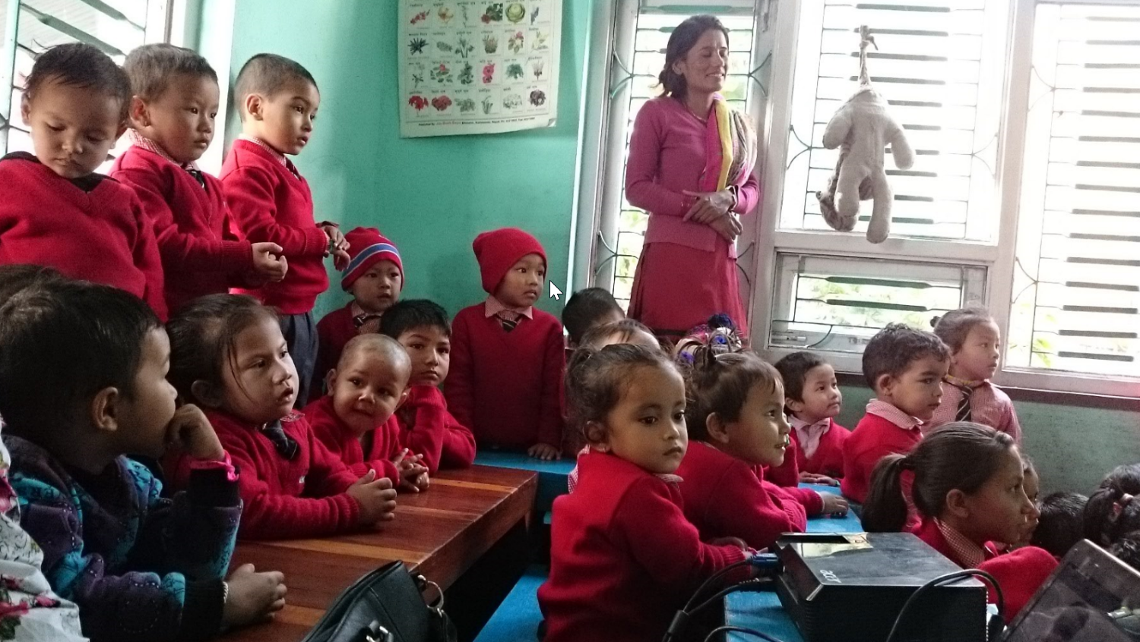
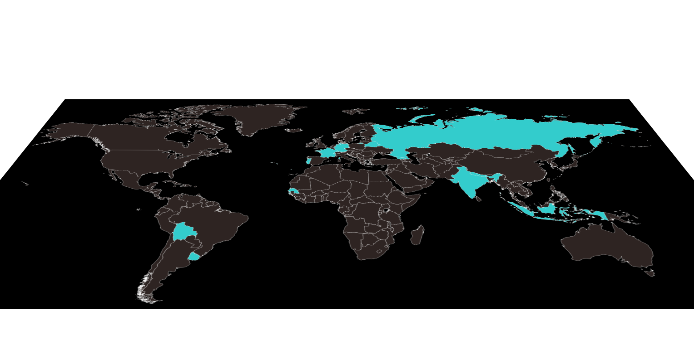
Results
Working as part-time volunteers the team has achieved in the last 2 years:
- Developed a cost-effective solution based on mobility,
12 countries with partnering organizations and institutions,
100+ lecturers involved in the network,
__ schools and school associations participating
In 2019 our lecturers gave visited 12 countries giving the lectures in science oriented but also in remote and underprivileged schools:
Kathmandu public schools (Nepal), Public schools Chennai, Bangalore, (India) Tambov villages (Russia), Science club network (Senegal)

Slide 6
Collaboration
LeWiBo provides
Organization of lectures given by our scientists at INFN host institutes
Dissemination of shareable outreach material
Access the host nodes in the LeWiBo for outreach and educational visit for INFN researchers.
Memorandum of Understanding to sign by two stakeholders
Sharing the news about the participation with INFN with the network
INFN provides:
?

Slide 7
Thank you!

